Slide 1
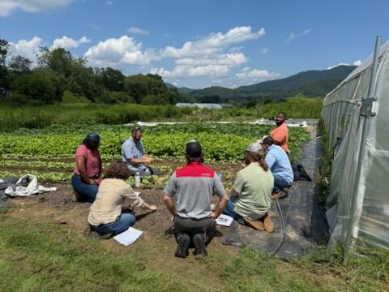

Training Notice
Planning CPS 336 Soil Carbon Amendment

Slide 2
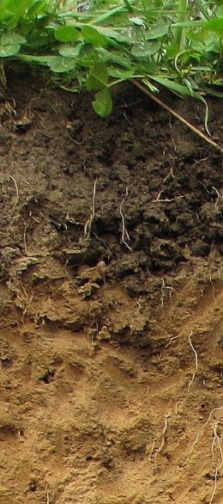
CPS 336 Soil Carbon Amendment
Offered to state staff, course instructors provided by Soil Health Division
Duration of 1-day
Combination of classroom and field activities
  Comprehensive review of the CPS 336
  Detailed discussions of planning and assessment tools
  Presentations on CPS 336 implementation and application
  Field activities to visit farms and SCA production facilities to gain insight on the complete process to go from feedstock to product application on the landscape.

